Slide 1
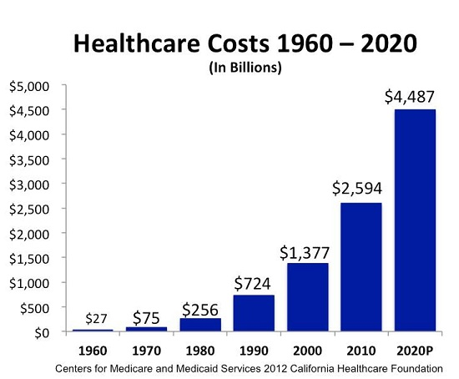
Problem: Medical Pricing Transparency
Team 106
In a study by Pew Research, 83% of those surveyed reported that the cost of medical procedures made quality care unaffordable.
In a survey, only 14% of respondents stated that they or someone they knew researched health care prices near them (KFF, 2021).
People need a convenient way to view and compare health costs between medical institutions.
Notes:
Link studies to statement by saying how health care costs are available, but difficult to access and compare.

Slide 2
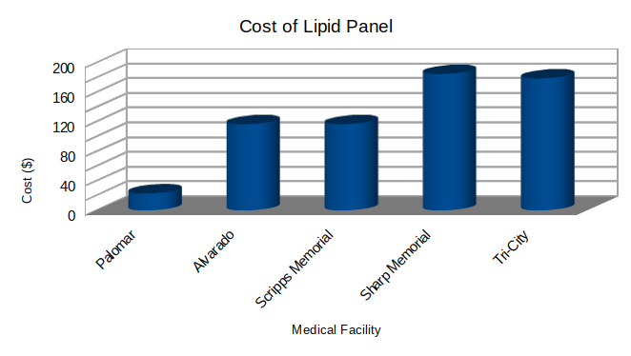
Our Application: Medical Procedure Price Comparison
Team 106
Our mobile, web-based application uses a dataset containing cost information to provide average pricing for various medical procedures and lab tests at different health care facilities.
Users can make an informed financial decision about where to receive medical care.
Our application strives to dramatically influence the patient experience at the very beginning and close the care gap.

Slide 3

Team 106
Speech
link

